Slide 1
Logic circuits
Individual Homework – Cantor Alexandru-Horatiu

Slide 2
THEORY ASPECTS

Slide 3
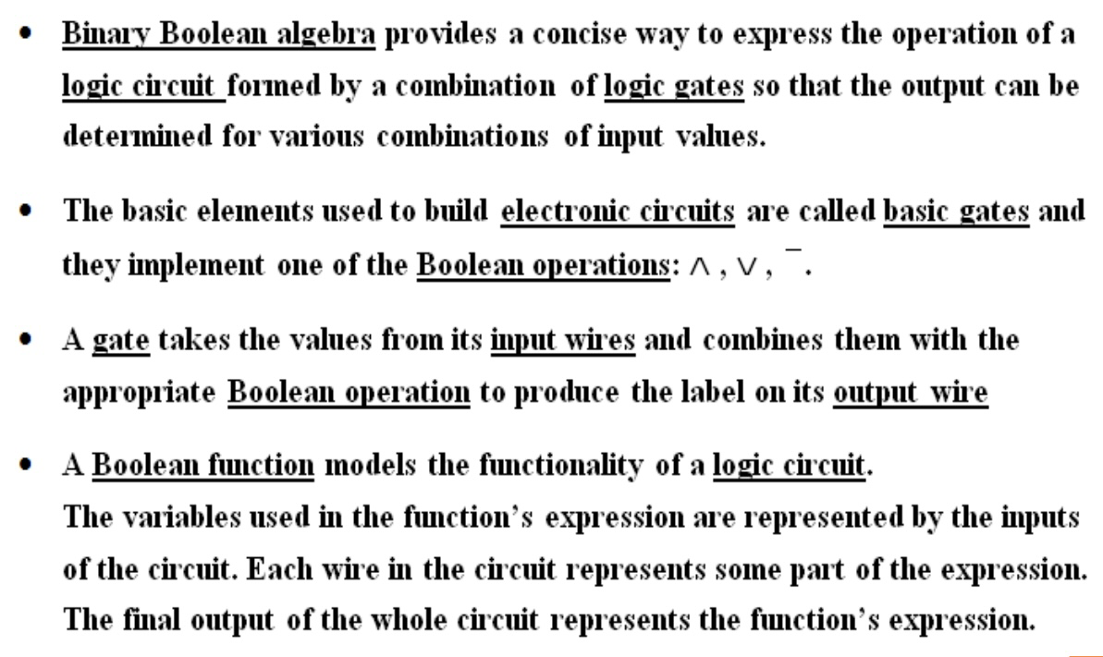
Logic circuits

Slide 4
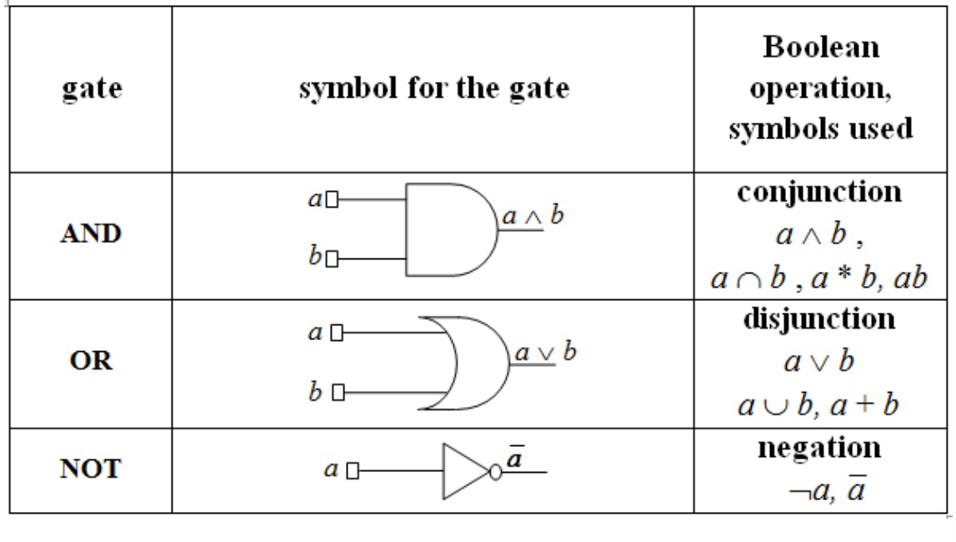
Basic gates

Slide 5
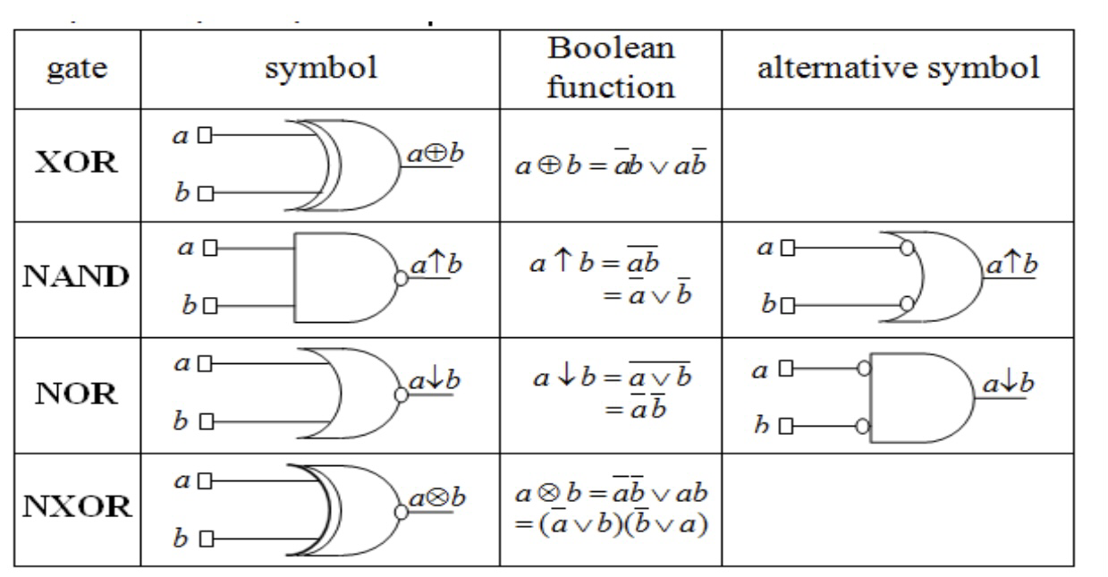
Derived gates

Slide 6
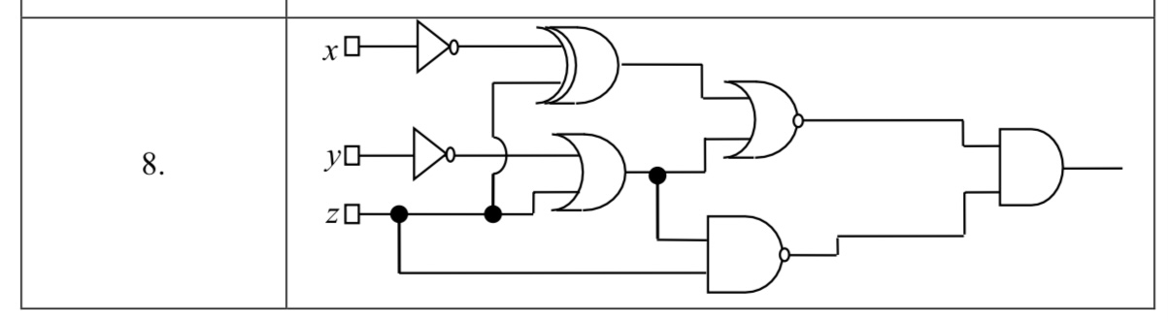
Problem statement 1.8
Write the corresponding Boolean function associated to the following logic circuit, then simplify it and draw a simplified equivalent circuit using only basic gates:

Slide 7
Solution
of problem statement 1.8

Slide 8
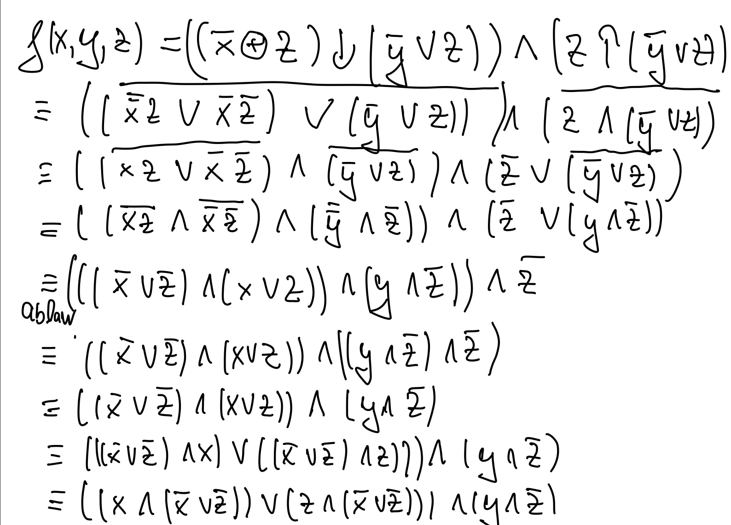

Slide 9
